Slide 1



Language in Cognitive Science
SESSION
THEORY AND LAB
1
mind · language · computation
Notes:
Welcome. This session sets the foundations: what language is, how human language compares with designed symbolic systems like logic and code, and why linguistics counts as a science. The lab makes these ideas concrete in Python.

Slide 2
Session outline
I
Definitions of language
Classic definitions, design features, competence vs performance, NLP and the NLP Trinity
II
Language and symbolic systems
Artificial vs natural language; grammar, probability and data; ambiguity
III
Linguistics as a scientific study
Scientific method, levels of analysis, layers of NLP, generations of NLP
Lab
Hands-on in Python
Parse code vs sentences, explore ambiguity with spaCy, test Zipf's law
SL
Self-learning
Readings and three short assignments
Learning outcomes. Define language from several perspectives, contrast natural and artificial languages, and explain what makes linguistics scientific.
Notes:
Section numbers refer to Chapter 1 of Bhattacharyya & Joshi, Natural Language Processing (Wiley India, 2023): 1.1 Language and Linguistics, 1.2 Ambiguity and Layers of NLP, 1.3 Grammar, Probability, and Data, 1.4 Generations of NLP. Self-learning (1 hour) comes after the lab: readings and short reflective tasks, listed near the end of the deck.

Slide 3

Definitions of language
I
What is language, and why does cognitive science care about it?

Slide 4
Language at the heart of cognitive science
I · DEFINITIONS OF LANGUAGE
Cognitive science studies the mind as an information-processing system.
Language is its richest window: it is uniquely human, children learn it effortlessly, and it links sound, structure, meaning and thought.
Each of the six disciplines of the field studies language from its own angle.
Linguistics
structure of languages
Philosophy
meaning, reference, truth
Psychology
acquisition, comprehension
LANGUAGE
Anthropology
language and culture
Neuroscience
Broca's and Wernicke's areas
Computer science
AI, formal models, NLP
the mind as an information processor
Notes:
This is the classic cognitive science hexagon: six disciplines, all connected. Language is the one topic that all six study, which is why it sits at the centre of the field. Neuroscience: Broca's and Wernicke's areas. Psychology: how we acquire, produce and comprehend language.

Slide 5
How scholars have defined language
I · DEFINITIONS OF LANGUAGE
Edward Sapir
1921
Emphasis: communication, symbols, uniquely human
“A purely human and non-instinctive method of communicating ideas, emotions and desires by means of a system of voluntarily produced symbols.”
Bloch & Trager
1942
Emphasis: arbitrariness, social function
“A system of arbitrary vocal symbols by means of which a social group co-operates.”
Noam Chomsky
1957
Emphasis: formal structure, infinite generativity
“A set (finite or infinite) of sentences, each finite in length and constructed out of a finite set of elements.”
WORKING DEFINITION FOR THIS COURSE
A structured system of arbitrary symbols, combined by rules, that a community uses to communicate and to think.
Notes:
Each definition emphasises something different. Sapir stresses communication and humanness; Bloch and Trager stress arbitrariness and social cooperation; Chomsky gives a formal, mathematical definition that also covers artificial languages. Ask students: which definition would include a programming language? (Chomsky's.)

Slide 6
Design features of human language
I · DEFINITIONS OF LANGUAGE
Hockett (1960) listed design features of human language. Six of them are most often used to separate it from animal communication and other symbol systems.
FEATURE | WHAT IT MEANS | EXAMPLE
Arbitrariness | No natural link between form and meaning | “dog”, “kutta”, “chien” name the same animal
Duality of patterning | Meaningless sounds combine into meaningful units | /k/ /æ/ /t/ → “cat”, “act”, “tack”
Productivity | Finite words and rules yield unlimited new sentences | You can understand a sentence never heard before
Displacement | Talk about the past, future, absent and imaginary | “Dinosaurs lived here millions of years ago.”
Discreteness | Speech is built from distinct units | /p/ vs /b/: “pat” vs “bat”
Cultural transmission | Learned from a community, not inherited | A child raised in Chennai acquires Tamil
Notes:
Hockett proposed 13 features in 1960 (later 16). Productivity and displacement are the strongest candidates for features unique to human language. Bee dances show some displacement; vervet monkey calls are not productive.

Slide 7






Design features at a glance
I · DEFINITIONS OF LANGUAGE
dog
kutta
chien
cat
act
tack
“I think that she said that he knows that …”
k
æ
t
1. Arbitrariness
2. Duality of patterning
3. Productivity
Three unrelated forms name one animal
A few meaningless sounds build many words
Finite words and rules, unlimited sentences
yesterday
next year
in a story
p
b
pat
bat
4. Displacement
5. Discreteness
6. Cultural transmission
Talk about what is not here and now
Change one unit, get a different word
Learned from the people around us
Compare the honeybee dance: it has displacement (it points to distant food) but is iconic, continuous and innate, so it lacks features 1, 5 and 6.
Notes:
A visual summary of the previous slide. Point to each panel and ask students for one more example from Hindi or their own language. The honeybee note at the bottom sets up the comparison: bees have displacement but lack arbitrariness, discreteness and cultural transmission.

Slide 8

Language as knowledge vs language as use
I · DEFINITIONS OF LANGUAGE
THE ABSTRACT SYSTEM
THE CONCRETE USE
knowledge in the mind
observable behaviour
Langue
the shared system of a community
Saussure, 1916
Parole
individual acts of speaking
Competence
a speaker's unconscious knowledge of grammar
Chomsky, 1965
Performance
actual speech, with slips, pauses and memory limits
I-language
internal, individual, mental
Chomsky, 1986
E-language
external: corpora, texts, utterances
Why it matters. Cognitive science treats language as a mental faculty. The aim is to model the knowledge in the mind (competence), using observed behaviour (performance) as evidence.
Notes:
Example of performance vs competence: a speaker may stumble on a long centre-embedded sentence (performance limit) while their grammar still licenses it (competence).

Slide 9
From linguistics to NLP: the NLP Trinity
I · DEFINITIONS OF LANGUAGE
NLP = Linguistics + Computation
Linguistics tells us what the phenomenon is; computation gives us the means to process it at scale.
Any piece of NLP work can be placed in a three-dimensional space: which problem, in which language, solved with which algorithm.
Example: part-of-speech tagging of Marathi with a CRF is one point in this space.
LANGUAGE
Tamil
Marathi
Hindi
English
PROBLEM
Morphology
POS tagging
Parsing
Semantics
Rules
HMM / CRF
Neural nets
ALGORITHM
Textbook: §1.1; the NLP Trinity is a recurring framework in Bhattacharyya's lectures
Notes:
The NLP Trinity: Problem (morphology, POS tagging, parsing, semantics ...), Language (English, Hindi, Marathi, Tamil ...), Algorithm (rule-based, statistical models such as HMM and CRF, neural networks). Ask students to place a familiar application, e.g. Google Translate for Hindi to English, in this space.

Slide 10

Language and symbolic systems
II
Artificial vs natural language; grammar, probability and data; ambiguity (Textbook §1.2–1.3)

Slide 11



What is a symbolic system?
II · LANGUAGE AND SYMBOLIC SYSTEMS
A symbolic system is a set of symbols, rules for combining them, and an interpretation that gives them meaning.
Saussure's linguistic sign
Peirce's three kinds of sign
Icon
resembles what it stands for
e.g. a map, a portrait, a pedestrian road sign
signified
concept TREE
Index
causally linked to what it stands for
e.g. smoke → fire, a footprint, a thermometer
signifier
sound pattern /triː/
Symbol
linked only by convention
e.g. words, numerals, “+”, a red traffic light
The bond is arbitrary: Hindi pairs the same concept with /peɽ/.
Notes:
Language is mostly symbolic in Peirce's sense, with some iconic corners (onomatopoeia like 'buzz'). Logical and programming languages are purely symbolic: their symbols mean exactly what the specification says.

Slide 12


Artificial languages: designed on purpose
II · LANGUAGE AND SYMBOLIC SYSTEMS
Logical languages
Programming languages
Propositional and first-order logic
Python, C, Java, SQL …
In English: All humans are mortal.
In English: Label every adult.
∀x ( Human(x) → Mortal(x) )
if age >= 18:
print("Adult")
Exact syntax and truth-conditional semantics
Every formula has exactly one reading
Built for reasoning and proof
Formal grammar (e.g. context-free / BNF)
Interpreted deterministically by a machine
One missing symbol and the program fails
In between: constructed human languages such as Esperanto and Lojban are designed like artificial languages but spoken by people.
Notes:
Both kinds of artificial language are 'languages' under Chomsky's formal definition: a set of strings generated from a finite alphabet by rules. They differ from natural language mainly in that their meaning is fixed by design rather than negotiated through use.

Slide 13
Natural vs artificial language
II · LANGUAGE AND SYMBOLIC SYSTEMS
DIMENSION | NATURAL LANGUAGE (Hindi, English, Tamil …) | ARTIFICIAL LANGUAGE (logic, Python …)
Origin | Evolved naturally within communities | Designed deliberately for a purpose
Ambiguity | Everywhere; resolved by context | Eliminated by design
Grammar | Implicit, learned, full of exceptions | Explicit, formal, no exceptions
Change | Constantly evolving (slang, borrowing) | Changes only by new specification/version
Error tolerance | High: we understand broken sentences | Low: one missing bracket breaks it
Meaning | Depends on context, intention, culture | Fixed formal semantics
Acquisition | Acquired natively by children | Learned explicitly, usually by adults
Expressiveness | Emotion, metaphor, humour, politeness | Limited to its domain (logic, computation)
Notes:
The single most important row for NLP is ambiguity. Natural language trades precision for efficiency: we reuse short words for many meanings and rely on context. Machines must reconstruct that context.

Slide 14


Languages on a spectrum, from natural to artificial
II · LANGUAGE AND SYMBOLIC SYSTEMS
Hindi, Tamil
evolved; millions of native speakers
Legal English
natural, but deliberately regulated
Lojban
constructed on predicate logic
First-order logic
fully formal; one meaning per formula
NATURAL
ARTIFICIAL
Indian Sign Language
natural, visual-gestural
Esperanto
constructed (1887); spoken by people
Python, SQL
designed for machines
moving right:
more design, more explicit rules
less ambiguity, less dependence on context
fewer (or no) native speakers
Notes:
The table on the previous slide presents two poles; real languages sit along a line between them. Esperanto (1887) is constructed but has native speakers; Lojban (1987) is constructed around predicate logic. Ask students where Hinglish or WhatsApp texting would go.

Slide 15



Grammar, probability and data
II · LANGUAGE AND SYMBOLIC SYSTEMS
An artificial language is fully specified by its grammar. A natural language is not: a grammar admits many analyses, and we need probability, estimated from data, to choose among them.
1
Grammar
2
Probability
3
Data
What structures are possible?
Which structure is most likely?
Where do the probabilities come from?
S → NP VP; VP → V NP PP
P(parse | sentence)
Annotated corpora, treebanks, raw text
Tells us that “I saw the man with the telescope” has two legal parses.
Ranks the parses: seeing with a telescope is more likely than a man holding one.
Counts how often “with” attaches to the verb vs the noun in real sentences.
The key contrast. Python needs only step 1: its grammar yields exactly one parse. Natural language needs all three, which is why NLP moved from hand-written rules to statistics and learning.
Notes:
This slide bridges Part II and the generations of NLP in Part III. Grammar alone over-generates analyses for natural language; probability ranks them; data supplies the probabilities. Lab Task 2 shows a trained parser making exactly this kind of choice.

Slide 16
Ambiguity: the central challenge of NLP
II · LANGUAGE AND SYMBOLIC SYSTEMS
(1)
Visiting aunts can be a nuisance.
POS / ROLE
COMPARE: CODE
a. visiting as adjective: aunts who visit (aunts are the agents)
b. visiting as gerund: going to visit aunts (aunts are the objects)
x = a + b * c
(2)
She went to the bank.
LEXICAL
always means a + (b × c). Operator precedence leaves no room for a second reading.
Natural language has no such rulebook, so a parser must guess from context. That is the core problem of NLP.
a. the side of a river
b. a financial institution
(3)
I saw the man with the telescope.
STRUCTURAL
a. I [saw [the man] [with the telescope]] I used the telescope
b. I [saw [the man with the telescope]] the man had it
(4)
Can you pass the salt?
PRAGMATIC
a. literal: a yes/no question about ability
b. intended: a polite request
Notes:
Example (1) is a classic from Bhattacharyya's teaching: the POS of 'visiting' decides who is doing the visiting. Another discourse-level example from his lectures: a mother tells John to go to school because it is open today, and warns that his father will be angry if he bunks: what is open, bunk what, and why will the father be angry? Numbered examples follow linguistics convention: (3a) and (3b) are the two bracketings. Ask students to produce an ambiguous sentence in Hindi or their own language. Lab Task 2 runs the telescope sentence through spaCy to see which reading the parser picks.

Slide 17




One sentence, two structures
II · LANGUAGE AND SYMBOLIC SYSTEMS
“I saw the man with the telescope.”
(a) I used the telescope to see him
(b) the man was holding the telescope
I
the man
I
the man
S
S
NP
VP
NP
VP
V
NP
PP
V
NP
I
saw
the man
with the telescope
I
saw
NP
PP
the man
with the telescope
PP attaches to the verb phrase
Notes:
Show the pictures first and ask students which reading they had in mind. Then show how the bracketings from the previous slide become trees: the only difference is where the PP 'with the telescope' attaches, to the verb phrase (a) or to the noun phrase (b). In Lab Task 2, spaCy's small English model chooses reading (b).

Slide 18

Linguistics as a scientific study
III
From linguistic analysis to the layers and generations of NLP (Textbook §1.2, 1.4)

Slide 19
What makes linguistics a science?
III · LINGUISTICS AS A SCIENTIFIC STUDY
Descriptive, not prescriptive
1 Observe
corpora, fieldwork, judgments
PRESCRIPTIVE · not science
Tells people how they should speak:
“Never end a sentence with a preposition.”
4 Revise
refine or replace the theory
the empirical cycle
2 Hypothesise
propose a rule
DESCRIPTIVE · science
Records and explains how people actually speak:
“Who are you talking to?” is normal English.
3 Test
predictions vs new data
Like any science, linguistics is empirical, systematic, objective, and its hypotheses can be falsified by a single counter-example.
Notes:
Example hypothesis: 'English adjectives come before nouns.' Counter-examples like 'something new' or 'the president elect' force a revision. A single grammatical sentence that a proposed rule forbids is a counter-example.

Slide 20
Levels of linguistic analysis
III · LINGUISTICS AS A SCIENTIFIC STUDY
LEVEL | WHAT IT STUDIES | EXAMPLE
Phonetics | Physical speech sounds | the puff of air after [p] in “pin”
Phonology | Sound patterns of a language | /p/ vs /b/ separates “pat” from “bat”
Morphology | Structure of words | un + happy + ness; Hindi laṛkiyā̃ = laṛkī + -yā̃
Syntax | Structure of sentences | [The dog] [chased [the cat]]
Semantics | Literal meaning | “bachelor” = unmarried adult man
Pragmatics | Meaning in context | “It's cold in here” = please close the window
Discourse | Meaning across sentences | “Ravi came in. He sat down.” (He = Ravi)
sound
meaning
Notes:
These levels map almost one-to-one onto the NLP pipeline: speech recognition (phonetics/phonology), tokenisation and lemmatisation (morphology), parsing (syntax), semantic role labelling (semantics), dialogue systems (pragmatics/discourse).

Slide 21
The layers of NLP
III · LINGUISTICS AS A SCIENTIFIC STUDY
Two lessons
Ambiguity arises at every layer, not just in meaning.
Errors at a lower layer propagate upward: a wrong POS tag leads to a wrong parse.
Discourse & coreference
Link meaning across sentences
“Ravi came in. He sat down.” He = Ravi
increasing complexity of processing
Semantics extraction
Who did what to whom
Ravi (agent) gave a book (theme) to Meena (recipient)
Parsing
Build the full syntactic structure
a constituency tree or dependency relations
Chunking
Group words into flat phrases
[The old dog]NP [was barking]VP
POS tagging
Assign a category to each word
The/DT dog/NN barks/VBZ
Morphology
Analyse word forms
played → play + -ed; Marathi/Hindi verbs carry tense and agreement in suffixes
Notes:
This is the NLP view of the linguistic levels on the previous slide: each layer is a processing task whose output feeds the next. Indian languages are morphologically rich, so the bottom layer does much more work for Hindi or Marathi than for English. Shallow parsing (POS tagging, chunking) and deep parsing are the subjects of the next chapters of the textbook.

Slide 22



Interdisciplinary branches of linguistics
III · LINGUISTICS AS A SCIENTIFIC STUDY
Linguistics
Psycho-
linguistics
Neuro-
linguistics
Socio-
linguistics
Computational linguistics
Historical linguistics
Applied linguistics
How the mind acquires, stores and processes language
How the brain supports language; aphasia studies
Variation by region, class, gender and context
Formal and statistical models; the science behind NLP
How languages change and are related (Sanskrit, Latin, Greek)
Language teaching, translation, speech therapy
Computational linguistics is where this course is heading: it treats language as a formal object that computers can model and process.
Notes:
Core linguistics covers the levels on the previous slide; these branches connect it to other disciplines, mirroring the cognitive science hexagon.

Slide 23
A short history of the scientific study of language
III · LINGUISTICS AS A SCIENTIFIC STUDY
c. 4th c. BCE
Pāṇini
Aṣṭādhyāyī: nearly 4,000 precise rules of Sanskrit grammar
1933
Bloomfield
Language: structuralism and rigorous empirical method
1990s
Statistical NLP
Large corpora and probabilistic models
1916
Saussure
Course in General Linguistics: language as a system of signs
1957
Chomsky
Syntactic Structures: generative grammar and the cognitive turn
2017 onward
Transformers & LLMs
Neural models learn language from massive text
Indian grammarians were doing formal linguistics two millennia before the West; Pāṇini's rule system is often compared to a modern formal grammar.
Notes:
Pāṇini's grammar uses rule ordering, meta-rules and compact notation, ideas that resurface in Backus–Naur Form used to define programming languages. That neatly connects Parts II and III.

Slide 24
Three generations of NLP
III · LINGUISTICS AS A SCIENTIFIC STUDY
 | 1ST GENERATION: RULE-BASED | 2ND GENERATION: STATISTICAL | 3RD GENERATION: NEURAL
Core idea | Experts write grammars and rules | Learn probabilities from annotated data | Learn dense representations end to end
Knowledge source | Linguists' intuition | Corpora and treebanks | Very large raw and annotated text
Typical methods | Context-free grammars, rule-based MT | HMM, CRF, phrase-based SMT | Word embeddings, RNNs, Transformers, LLMs
Strength | Precise and explainable | Robust; handles ambiguity by likelihood | State-of-the-art accuracy across tasks
Weakness | Brittle; costly to scale to new languages | Needs labelled data; feature engineering | Data-hungry; hard to interpret
Connection to this session. Generation 1 treats natural language like an artificial language (grammar only); generations 2 and 3 add probability and data, the ingredients from Part II.
Notes:
The textbook organises every later chapter (NER, NLI, machine translation, sentiment analysis, question answering, summarisation) by these three generations. The lab tasks also follow this arc: Task 1 is grammar-only, Task 2 uses a trained parser, Task 3 looks at the statistics of raw data.

Slide 25
How each generation handles the telescope sentence
III · LINGUISTICS AS A SCIENTIFIC STUDY
1ST GENERATION
Rules
2ND GENERATION
Statistics
3RD GENERATION
Neural networks
VP → V NP PP
VP → V NP
NP → NP PP
attach to “saw” (a)
0.62
saw
attach to “man” (b)
Result: two valid parses, (a) and (b). The grammar alone cannot choose.
0.38
man
Illustrative probabilities from treebank counts. Result: pick the more probable parse.
Words in, attachment out
Lab result: spaCy's small English model (a neural parser) attaches “with” to “man”, choosing reading (b).
Each generation adds something the earlier one lacked: rules give the possibilities, statistics rank them, and neural models learn the ranking from data without hand-built features.
Notes:
The probabilities in the middle column are illustrative, not measured. The point: generation 1 can only list the legal parses; generation 2 ranks them by how often each attachment occurs in annotated data; generation 3 learns the choice inside a neural network. In the lab, spaCy's small English model attaches 'with' to 'man'.

Slide 26

Natural vs artificial language, hands-on
Lab
Python 3.9+, spaCy (en_core_web_sm), NLTK, matplotlib

Slide 27
Lab plan
ACTIVITY | WHAT STUDENTS DO | OUTPUT
Setup | pip install spacy nltk matplotlib python -m spacy download en_core_web_sm | Working environment
Task 1: Grammar only (Gen 1) | Parse a Python expression with ast; split an English sentence; compare what each “grammar” returns | Note on how precedence fixes structure
Task 2: A trained parser (Gen 2–3) | Parse the four ambiguous sentences with spaCy; inspect heads and dependencies; draw both readings by hand | Which reading did spaCy pick, and why?
Task 3: Data and probability | Test Zipf's law: count word frequencies in a novel; plot rank vs frequency on log–log axes | Plot and a one-paragraph interpretation
Wrap-up | Share findings: what can a machine read directly, and what must it infer? | Class discussion
Notes:
Total 120 minutes. Students can work in pairs. The three tasks follow the textbook's arc from grammar (§1.3) through the generations of NLP (§1.4). Tasks 1 and 2 connect to Part II (natural vs artificial language); Task 3 shows that natural language, unlike a designed language, has strong statistical regularities that nobody designed.

Slide 28
Structure in code vs structure in English
LAB · TASKS 1 AND 2
Task 1 · Python's own parser
Task 2 · spaCy dependency parse
import ast
# An artificial language: one fixed parse
tree = ast.parse("x = a + b * c")
print(ast.dump(tree, indent=2))
# A natural-language sentence: just a string
sent = "I saw the man with the telescope"
print(sent.split())
import spacy
nlp = spacy.load("en_core_web_sm")
sentences = [
"Visiting aunts can be a nuisance.",
"She went to the bank.",
"I saw the man with the telescope.",
"Can you pass the salt?",
]
for s in sentences:
for tok in nlp(s):
print(tok.text, tok.dep_, tok.head.text)
print()
Exercise. Find where the tree puts b * c. Can you write the expression so it parses the other way?
Exercise. What is the head of “with”? Draw the tree for the other reading on paper.
Notes:
Expected: ast.dump shows BinOp(left=a, op=Add, right=BinOp(b, Mult, c)). For the telescope sentence, en_core_web_sm usually attaches 'with' to the verb 'saw' (instrument reading), but students should see that the other attachment is equally grammatical.

Slide 29
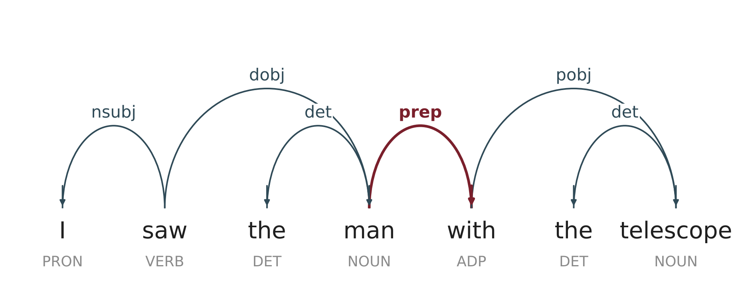
What the two parsers return
LAB · TASKS 1 AND 2
Task 1 · Python's ast: one tree, always
Task 2 · spaCy: one tree, chosen by a model
Assign
Name x
BinOp +
Name a
BinOp ×
Name b
Name c
Real output of en_core_web_sm. The highlighted arc shows “with” depending on “man”: reading (b). Arrows point from head to dependent.
b * c sits lower in the tree, so it is computed first: precedence is built into the grammar.
nsubj = subject · dobj = direct object · prep = preposition · pobj = object of preposition · det = determiner
Notes:
Both outputs are real. Left: the structure inside ast.dump for x = a + b * c, drawn as a tree. Right: spaCy en_core_web_sm's dependency parse of the telescope sentence, generated from the model's output. Note that spaCy attaches 'with' to 'man' (prep), i.e. reading (b). A trained parser commits to one reading; it gives no warning that another reading exists.

Slide 30
Zipf's law: a regularity nobody designed
LAB · TASK 3
import nltk, collections
import matplotlib.pyplot as plt
nltk.download("gutenberg")
words = [w.lower() for w in
nltk.corpus.gutenberg.words("austen-emma.txt")
if w.isalpha()]
freq = collections.Counter(words).most_common()
ranks = range(1, len(freq) + 1)
plt.loglog(ranks, [f for _, f in freq])
plt.xlabel("Rank"); plt.ylabel("Frequency")
plt.show()
print(freq[:10])
Interpret. Is your log–log plot close to a straight line? Which words top the list, and would a programming language's keywords follow the same law?
Notes:
Zipf's law: the r-th most frequent word occurs roughly 1/r as often as the most frequent word. On log-log axes this is a straight line with slope about -1. Function words (the, to, and, of) dominate the top ranks.

Slide 31
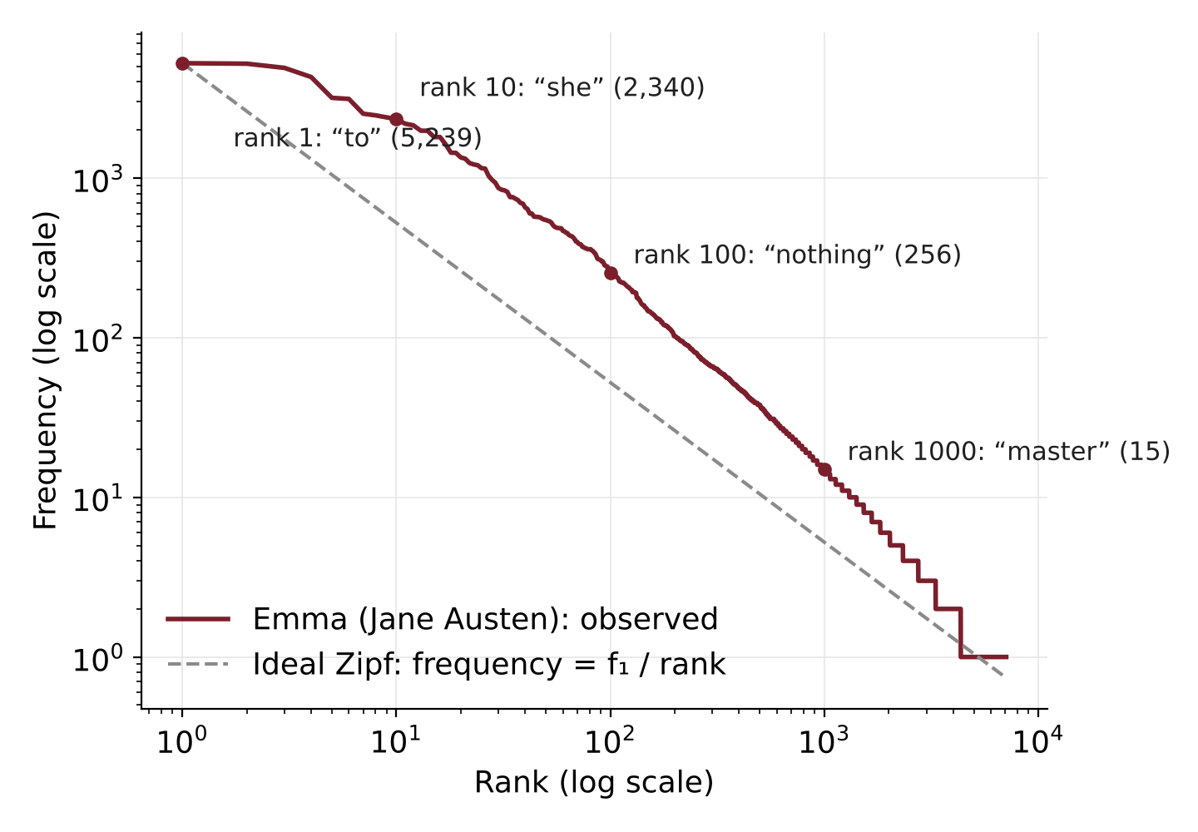
What you should see: Zipf's law in Emma
LAB · TASK 3
TOP 10 WORDS IN EMMA
1
to
5,239
2
the
5,201
3
and
4,896
4
of
4,291
5
i
3,178
6
a
3,129
7
it
2,528
8
her
2,469
9
was
2,398
10
she
2,340
161,600 word tokens, 7,079 distinct words. The ten words above, all function words, make up about a fifth of the novel.
Notes:
This is the actual output of the Task 3 code (NLTK Gutenberg corpus, austen-emma.txt, alphabetic tokens lower-cased): 161,600 tokens and 7,079 distinct words. The observed curve runs roughly parallel to the ideal 1/rank line over most of the range; the top ranks are function words.

Slide 32
Readings and assignments
SELF-LEARNING · 1 HOUR
READINGS
ASSIGNMENTS
Bhattacharyya, P. & Joshi, A. (2023). Natural Language Processing. Wiley India. Ch. 1, §1.1–1.4 (core reading).
1
Reflect (300 words). Is Python a “language” by Hockett's design features? Where would Python parsing sit in the NLP Trinity?
Fromkin, V., Rodman, R. & Hyams, N. An Introduction to Language, Ch. 1 “What Is Language?”
2
Collect ambiguity. Find 5 ambiguous sentences in Hindi or your own language and label each: lexical, POS, structural or pragmatic.
Hockett, C. F. (1960). The origin of speech. Scientific American, 203(3).
3
Map the layers. Take one Hindi sentence and write out its analysis at each layer of NLP, from morphology to discourse.
Notes:
Submit the reflection and ambiguity list before Session 2. The ambiguity list will be reused when we look at parsing.

Slide 33
Key takeaways
SUMMARY
1
Language is a rule-governed system of arbitrary symbols, distinguished by features such as productivity and displacement.
2
Artificial languages need only a grammar; natural language is ambiguous at every layer, so NLP also needs probability and data.
3
Linguistics is a descriptive, empirical science; its levels become the layers of NLP, tackled by three generations of methods.
For discussion. If a large language model produces fluent text, does it have language in Sapir's sense, or only in Chomsky's formal sense?
Notes:
Close with the discussion question; it ties together the definitions (Part I), the formal vs natural contrast (Part II), and computational linguistics (Part III).

